Slide 1
CSI ZG515/ SS ZG515 Data Warehousing
Swarna Chaudhary
Assistant Prof.

Slide 2

The slides presented here are obtained from the authors of the books and from various other contributors. I hereby acknowledge all the contributors for their material and inputs.
I have added and modified a few slides to suit the requirements of the course.

Slide 3
Session 3
Architectural Components of a Data Warehouse
Swarna Chaudhary
(swarna.chaudhary@pilani.bits-pilani.ac.in)

Slide 4
Outline
Data Warehousing Architecture
Ralph Kimball vs Inmon approach to Data Warehousing
Data Marts
Staging Area
OLAP

Slide 5
Recap of Previous Session
Dimensional Modelling
STAR vs Snowflake Schema
Facts
Granularity of Facts
Kinds of Fact table

Slide 6
Facts
The foundation of the data warehouse.
Granularity of the fact table
Facts are generally additive, can be summed up across the dimensions
Facts should be consistent with the grain
Build Up from the Lowest Possible Grain

Slide 7
Kinds of Fact tables
Transaction Fact table
Factless Fact Table
Periodic Snapshot Fact Table
Centipede Fact Table
Accumulating Snapshot fact table

Slide 8
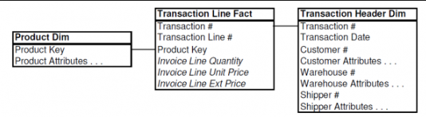
Transaction Fact Table
Represents an event that occur at a particular point in time,
For example, beep of the Scanner at the store.
Atomic transaction grain fact tables are the most expressive fact tables

Slide 9
Factless Fact Table
fact tables that do not contain any numerical measures.
comprise only foreign keys for different dimension tables.
Capture events and not to store information about business processes.
For example, Student attending a class on a given day
Are used to analyze what didn’t happen.
These queries always have two
parts:
A factless coverage table
An activity table

Slide 10
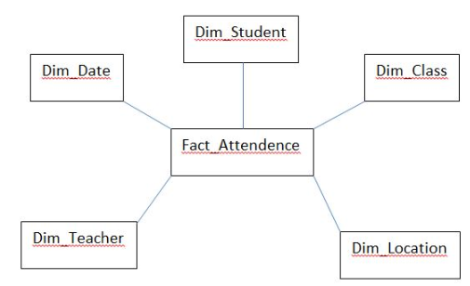
Factless Fact Table

Slide 11
Factless Fact Table
Q: Which products were under promotion but did not sell?
Cannot answer! -> POS sales fact table has only products that were sold
Factless Fact Table = has no measurement metrics -> determine what product where on promotion but did not sell
2 step process to answer Q
Query the promotion coverage table
Determine what products sold from the POS sales fact table
So -> the answer is the set difference between these 2 lists of products.

Slide 12
Factless table
Product Dimension
Date_key
Product_key
Store_key
Promotion_key
Promotion Count (=1)
Date Dimension
Promotion Dimension
Store Dimension

Slide 13
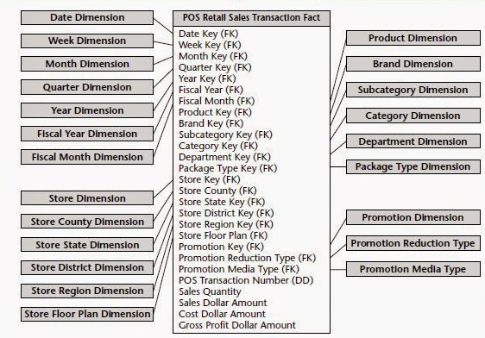
Centipede Fact Table
Is a normalized fact table.
It can normalize the fact instead of snow flaking dimensions tables

Slide 14
Periodic snapshot Fact Table
A row in a summarizes many measurement events occurring over a period, such as a week, or a month.
The grain is the period, not the individual transaction.
These are generally semi-additive or non-additive.

Slide 15
Accumulating Snapshot Fact Table
A row in an accumulating snapshot fact table summarizes the measurement events that has a well-defined beginning and end.
An event consisting of a series of predictable steps.
For example, the processing of an order.
Accumulating snapshots almost always have multiple date stamps, representing the predictable major events or phases

Slide 16
Data Warehousing Architecture
Data Warehousing Architecture
Data Marts
Staging Area
OLAP

Slide 17
Data Warehousing Architecture
Top-tier: Front-end
Tools
Middle-tier: OLAP Server
Middle-tier: OLAP Server
Middle-tier: OLAP Server
Middle-tier: OLAP Server
Bottom-tier: Data Warehouse Server
Bottom-tier: Data Warehouse Server
Bottom-tier: Data Warehouse Server
Bottom-tier: Data Warehouse Server
Sales
Direct Operational Reporting
Operational
Reports
Operational Data Store
Data Warehouse
Sales DM
HR
Dashboards
ETL
Staging Area
Finance DM
Sales
Model
Operations
ETL
Analytics
ETL
MDM
ETL
Process
Operation DM
Finance
Data Cleansing System
Data Mining
HR DM
Finance
Model
Source Systems
Data Storage and Aggregation
User Access

Slide 18
Data Marts
A subset of a data warehouse that supports the requirements of a particular department or business process
is designed for use by a specific department. E.g., Marketing, Sales, HR or finance.
Is often controlled by a single department in an organization.
Characteristics include:
Does not always contain detailed data unlike data warehouses
More easily understood and navigated
Approach
Bill Inmon
Ralph Kimball

Slide 19
DW vs DM
 | Data Warehouse | Data Marts
Scope | Enterprise-wide | Line of Business
Subject | Multiple | Single Subject
Data Sources | Many | Few
Size | 100 GBs - TBs | <100 GBs
Time to Implement | Months -Years | Months

Slide 20
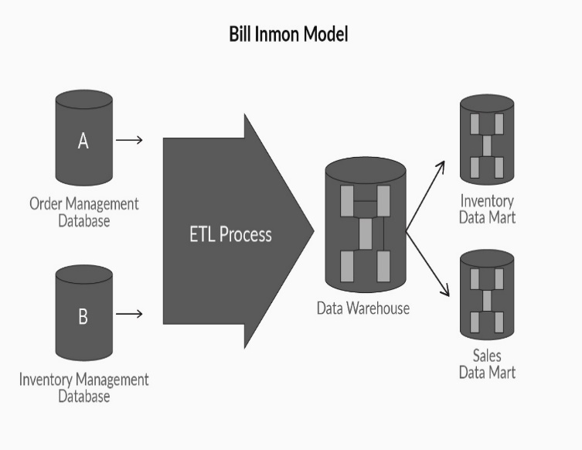
Bill Inmon Approach
Pros:
Centralized source of truth for the enterprise
Data update anomalies are avoided hence, makes ETL process easier and less prone to failure.
The business processes can be understood easily, as the logical model represents the detailed business entities.
Very flexible
Can handle varied reporting needs across the enterprise.
Cons:
Model can become complex over time.
Need resources who are experts in data modeling,
can be hard to find and are often expensive.
Initial set-up and delivery will take more time,
More ETL work is needed.
Large team of specialists is required

Slide 21
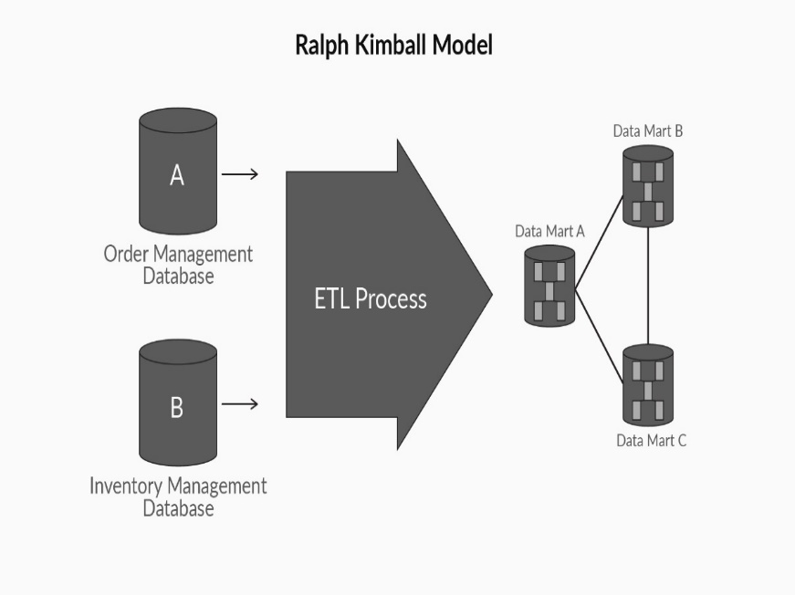
Kimball Approach
Pros:
Quick to set-up and build,
The star schema can be easily understood by the business users and is easy to use for reporting.
it occupies less space in the database
Performance of the star schema model is very good.
Small team of developers and architects is required
Works really well for department
Cons:
The essence of the ‘one source of truth’ is lost,
Redundant data can cause data update anomalies
over time.
Cannot handle all the enterprise reporting
Integration of legacy data into the data warehouse
can be a complex process.

Slide 22
Kimball vs Inmon Approach
When a data architect is asked to design and implement a data warehouse from the ground up, what architecture style should he or she choose to build the data warehouse?
What criteria can help an architect choose between the Inmon or the Kimball architecture?

Slide 23
Kimball vs Inmon Approach
Reporting Requirements – If the reporting requirements are strategic and enterprise-wide then Inmon works best. If the reporting requirements are tactical and business process/team oriented, then Kimball works best.
Project Urgency – If the organization has enough time to wait for the first delivery of the data warehouse (say 4 to 9 months), then Inmon approach can be followed. If there is very little time for the data warehouse to be up and running (say, 2 to 3 months) then the Kimball approach is best.
Future Staffing Plan – If the company can afford to have a large sized team of specialists to maintain the data warehouse, then the Inmon method can be pursued. If the future plan for the team is to be thin, then Kimball is more suited.
Frequency of Changes – If the reporting requirements are expected to change more rapidly and the source systems are known to be volatile, then the Inmon approach works better, as it is more flexible. If the requirements and source systems are relatively stable, the Kimball method can be used.

Slide 24
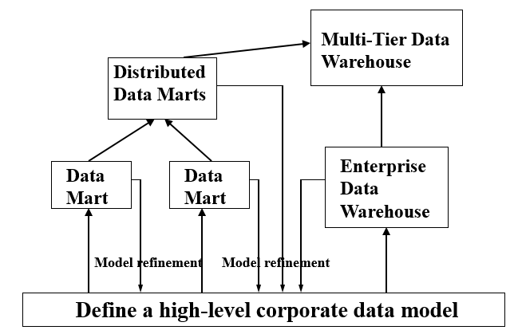
Hybrid Approach

Slide 25
Types of Data Mart
Dependent
Independent
Hybrid

Slide 26
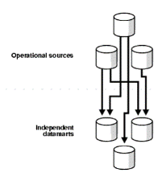
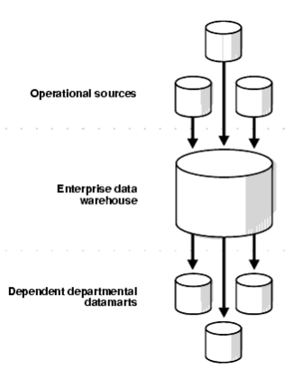
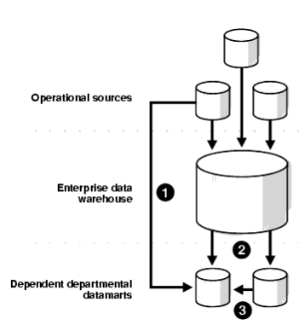
Types of Data Mart
Independent Data Marts
Dependent Data Marts
Hybrid Data Marts

Slide 27
ETT Process for Data Marts
Dependent
Independent

Slide 28
Pros and Cons of Data Mart
Pros
This Data is valuable to a specific group of people in an organization.
It is cost-effective alternatives to a data warehouse, which can take high costs to build.
allows faster access of Data.
easy to use as it is specifically designed for the needs of its users.
less implementation time compare to Data Warehouse systems
Cons
Data Mart cannot provide company-wide data analysis as their data set is limited.
Too many disparate and unrelated data marts can be difficult to maintain.

Slide 29
Staging Area
Intermediate data storage which is used for data processing during ETL
A storage area where extracted data is
Cleaned
Transformed
Deduplicated
Initial storage for data
Sits between data sources and DW
Need not be based on Relational model
number of staging areas used for ETL process depends on the complexity of the ETL process and may vary from problem to problem.
Spread over a number of machines
Does not provide data access to users
Analogy – kitchen of a restaurant

Slide 30
Staging Area Functions
Consolidation
Independent schedule/Multiple targets
Cleansing data
Aggregate pre-calculation
Data archiving and troubleshooting

Slide 31
Staging Area
Why can’t we process everything on the fly and push them in the data warehouse?".
Is it preferred to carry out an ETL process without any staging areas?
Can data be directly extracted from data sources, transformed on the fly, and loaded into a data warehouse?

Slide 32
Staging Area: Pros
Source systems are only available for extraction during a specific time.
Extracting data from two or more servers/sources based on some condition.
Many times, data warehouse’s data loading frequency does not match with the refresh frequencies of the source systems.
Extracted data from the same set of source systems can be used in multiple places (data warehouse loading, ODS loading, third-party applications etc.)
ETL process involves complex data transformations that require extra space to temporarily stage the data, which can’t be done on the fly.
https://dwbi.org/etl/etl/52-why-do-we-need-staging-area-during-etl-load

Slide 33
Staging Area: Cons
Staging area increases latency
Data in the staging area occupies extra space.
https://dwbi.org/etl/etl/52-why-do-we-need-staging-area-during-etl-load

Slide 34

What is OLAP?
OLAP (online analytical processing) is a computing method that enables users to easily and selectively extract and query data in order to analyze it from different points of view.
Helps in decision making
Need for Multidimensional Analysis
Fast Access & Powerful Calculations

Slide 35
A Sample Data Cube
Date
Total annual sales
of TVs in U.S.A.
1Qtr
2Qtr
3Qtr
4Qtr
sum
Product
TV
PC
U.S.A
VCR
sum
Canada
Country
Mexico
sum

Slide 36
How OLAP Systems Work?
Data stored in a Data warehouse is organized into data cubes.
Each OLAP cube contains data categorized by different dimensions (such as customers, geographic sales region and time period) derived by dimensional tables in the data warehouses.
Dimensions are then populated by members (such as customer names, countries and months) that are organized hierarchically.
OLAP cubes are often pre-summarized across dimensions to drastically improve query time over relational databases.

Slide 37
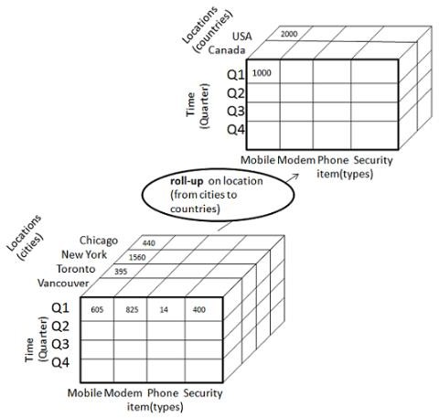
OLAP – Roll up
The following diagram illustrates how roll-up works
Roll-up is performed by climbing up a concept hierarchy for the dimension location.
Initially the concept hierarchy was "street < city < province < country".
On rolling up, the data is aggregated by ascending the location hierarchy from the level of city to the level of country.

Slide 38
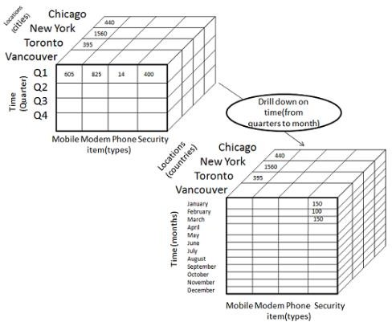
OLAP – Drill Down
Drill-down is the reverse operation of roll-up.
The following diagram illustrates how drill-down works:
Drill-down is performed by stepping down a concept hierarchy for the dimension time.
Initially the concept hierarchy was "day < month < quarter < year."

Slide 39
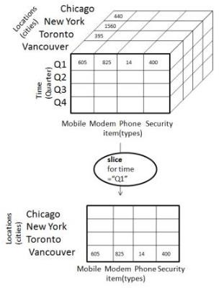
OLAP – Slice
The slice operation selects one particular dimension
from a given cube and provides a new
sub-cube.

Slide 40
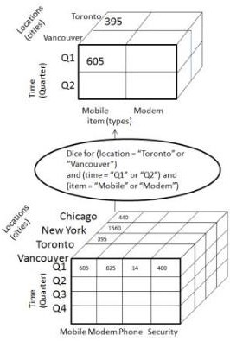
OLAP – Dice
Dice selects two or more dimensions from a given cube and provides a new sub-cube.
Consider the following diagram that shows the dice operation.
The dice operation on the cube based on the
following selection criteria involves three
dimensions.
(location = "Toronto" or "Vancouver")
– (time = "Q1" or "Q2")
(item =" Mobile" or "Modem")

Slide 41
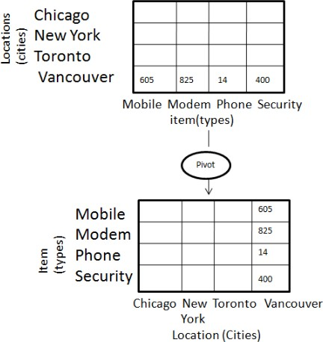
OLAP – Pivot
The pivot operation is also known as rotation.
It rotates the data axes in view in order to
provide an alternative presentation of
data.

Slide 42
Thank You

